Slide 1
ENGI 301 USB Audio Player PCB Proposal
11/15/21
Kevin Sun

Slide 2
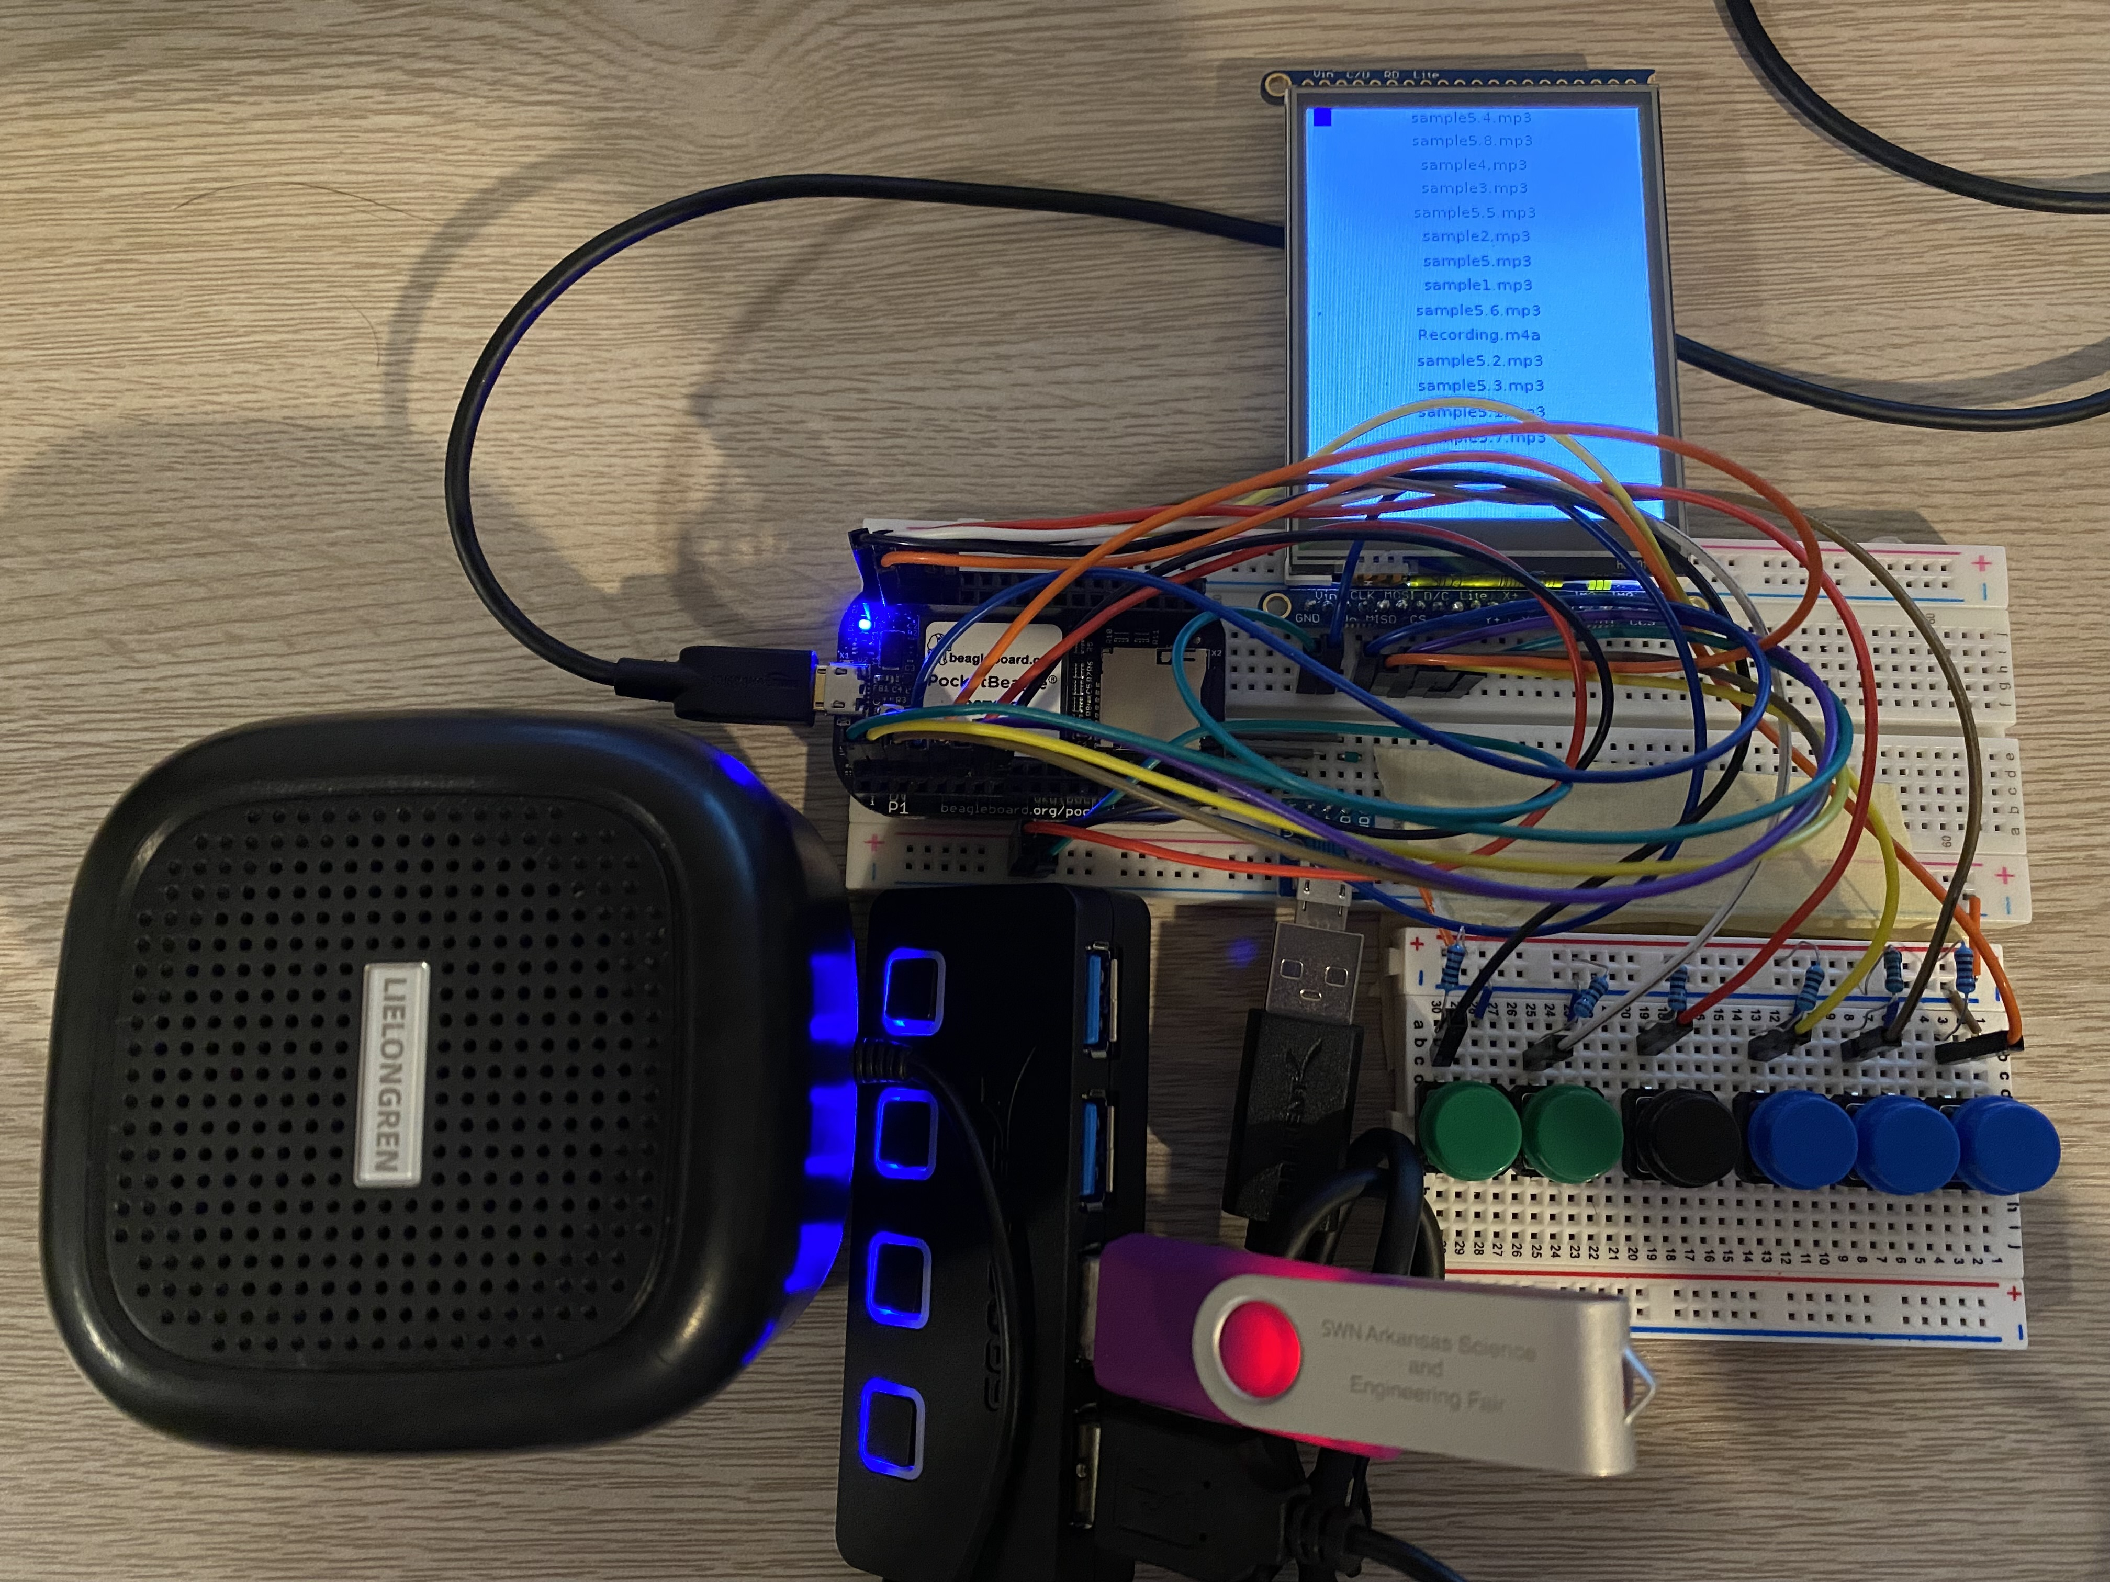
Background Information
The goal of this project is to create a PCB that will be used in a device which will read, display, and play songs from a USB drive.
The PCB will connect the Pocket Beagle buttons, Powered USB ports, and SPI screen of the device.
A detailed description of the previous build using the PocketBeagle on breadboards can be found here: https://www.hackster.io/432580/usb-music-player-with-the-pocketbeagle-0b1624
The code needed to run the project can be found here: https://github.com/ks76rice/ENGI301/tree/main/project_01

Slide 3
System Block Diagram
USB Speaker
USB Hub
USB Port
GPIO_IN (P2.02)
Button (Down)
USB
GPIO_IN (P2.04)
Button (Up)
GPIO_IN (P2.06)
Button (Play)
GPIO_IN (P2.08)
Button (Pause)
CLK (P1.08)
MISO (P1.10)
MOSI (P1.12)
CS (P1.06)
D/C (P1.04)
LCD (ILI9341)
Notes:
Going to need a USB speaker or could get a USB hub
Buttons will just user digital input
Look for libraries – aplay, adafruit for SPI SREENS

Slide 4
Components Required
Component List:
4X push buttons
LCD display
USB Host Port
USB Hub (Powered)
Pocket Beagle

Slide 5
Mechanical Block Diagram
5”
.1”
.1”
USB Hub
SPI Display
Button
.05”
Pocket Beagle
.5”
2”
2”
3”
USB
3”
Button
USB Host Port
.5”
.05”
.1”
.5”
FRONT
BACK

